Slide 1


How CFD can improve the design process
CFD for Pump Design

Slide 2
Agenda
What is CFD?
Why CFD?
Design Challenges
Test Case
Pre-processing
Simulation Set-up
Post-processing
Pump Curve
Result summary
Notes:
Snap-shot is taken from the simulation of the test case pump in the following slides

Slide 3
What is CFD?
Describes the velocity and pressure fields in the computational domain
Gives the numerical solution of the Navier-Stokes equations
Physical System
Mathematical Model
Discrete Model
Discrete Solution
Analytical modeling
Discretization
Solution
Notes:
The area of interest is subdivided into a large number of cells. In each, the Navier-Stokes equations can be rewritten as algebraic equations that relate the velocity and pressure to the values in the neighboring cells
- Analytical modeling: formulation of the mathematical equations that models the physical problem (PDE + IC + BC)
- Discretization: reduction of the mathematical model to a discrete model
Solution: solution of the discrete problem on a digital computer.

Slide 4
Why CFD?
Without CFD
Design
Test
Manufacture
Change design
Mass production
With CFD
Design
Change design
CFD
Mass production
Notes:
- Better designs, lower risk, and faster time to the marketplace for the product

Slide 5
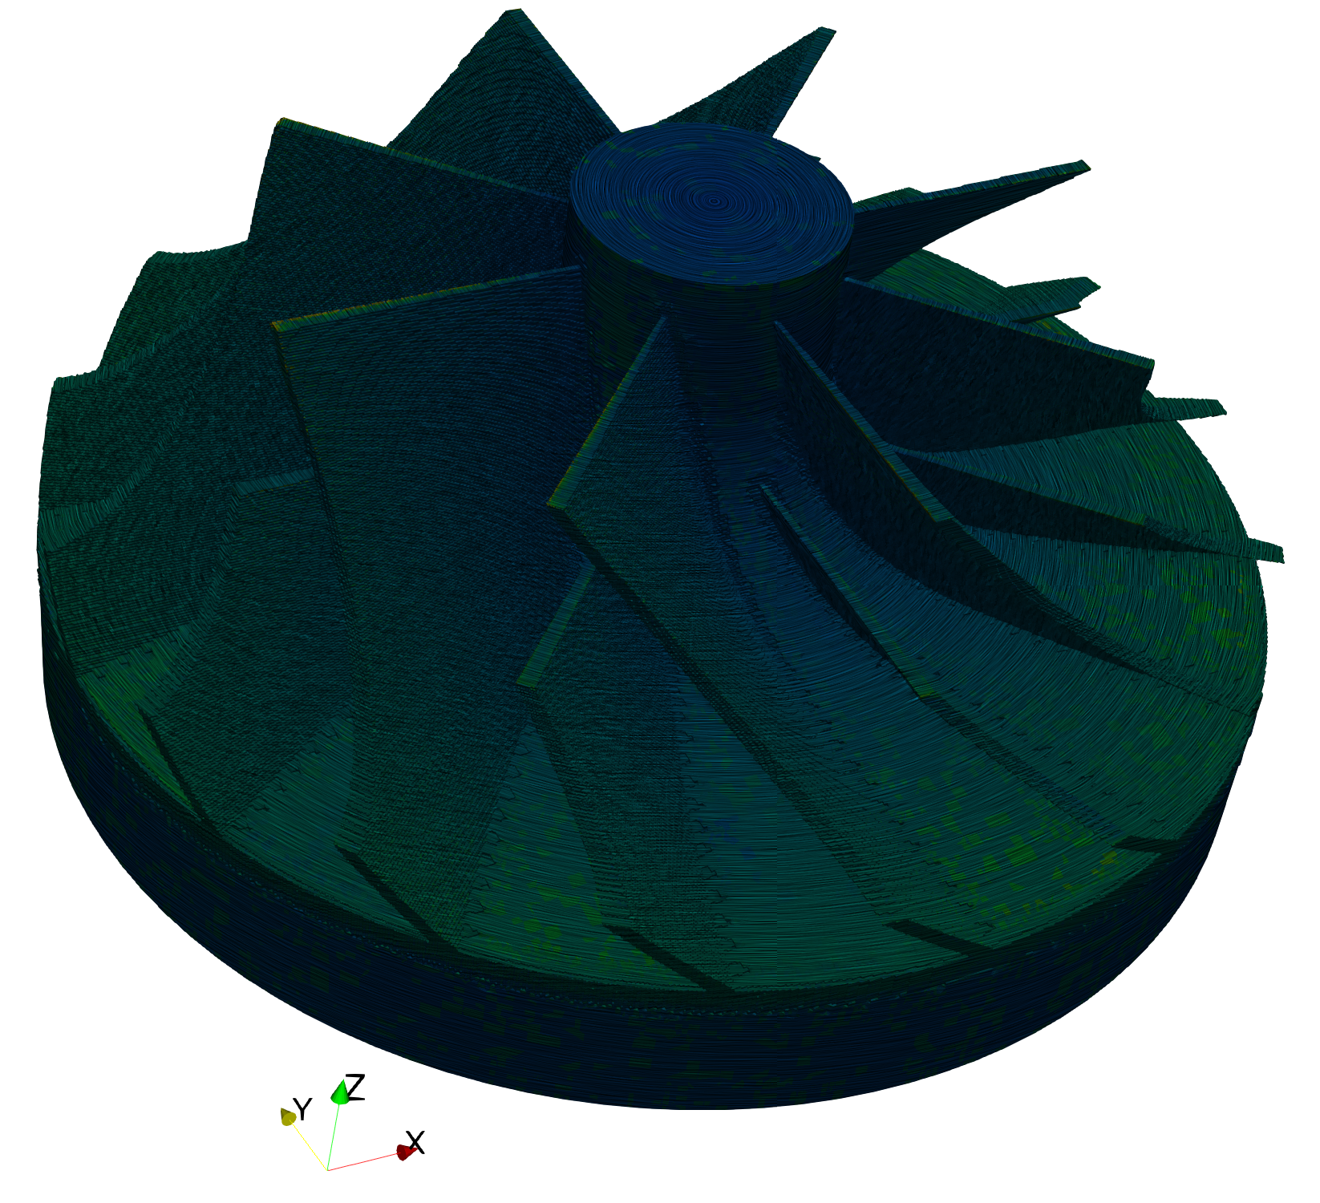
Design Challenges
How to:
Choose the best blade count?
Choose the best blade angle?
Determine the optimum housing design?
Predict cavitation?
Determine pump curves?
Notes:
To improve the accuracy of cavitation prediction:
Proper boundary layer modeling
Transient simulation
- Snap-shot is taken from the simulation of the test case pump in the following slides

Slide 6
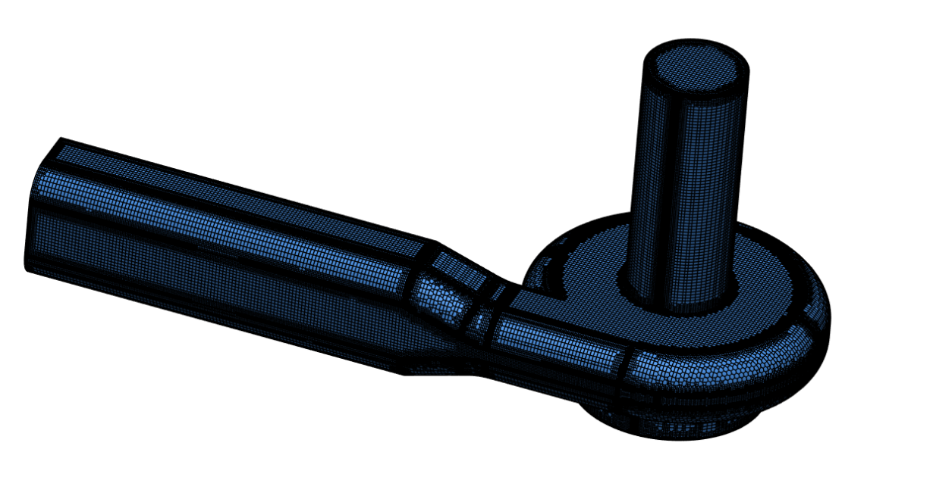
Test Case – Preprocessing
Mesh:
Elements: 6.4 million
Duration: 114 minutes
Core hours: 30.4
Rotating Zone:
Approach: Multi Reference Frame
Used for steady-state time dependency
Computationally cheaper than others
Notes:
Steady-state is used for simulating constant flows

Slide 7
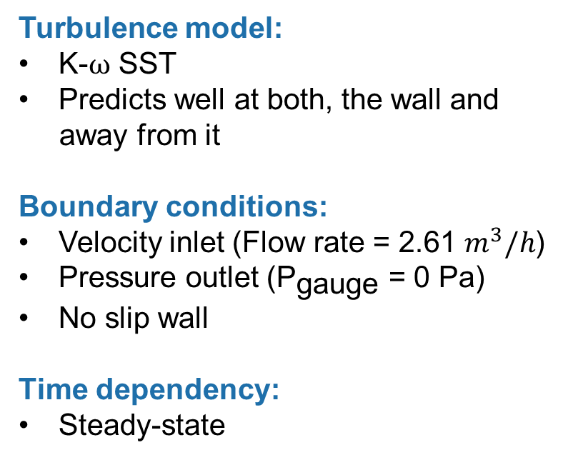
Test Case – Simulation Set-up
Turbulence model:
K-$ω$ SST
Predicts well at both, the wall and
away from it
Boundary conditions:
Velocity inlet (Flow rate = 2.61 $m^{3}/h$)
Pressure outlet (${\text{P}}_{\text{gauge}}$ = 0 Pa)
No slip wall
Time dependency:
Steady-state
Notes:
Since it is not possible to resolve the turbulence in small scales, turbulence models is used to reduce computation

Slide 8
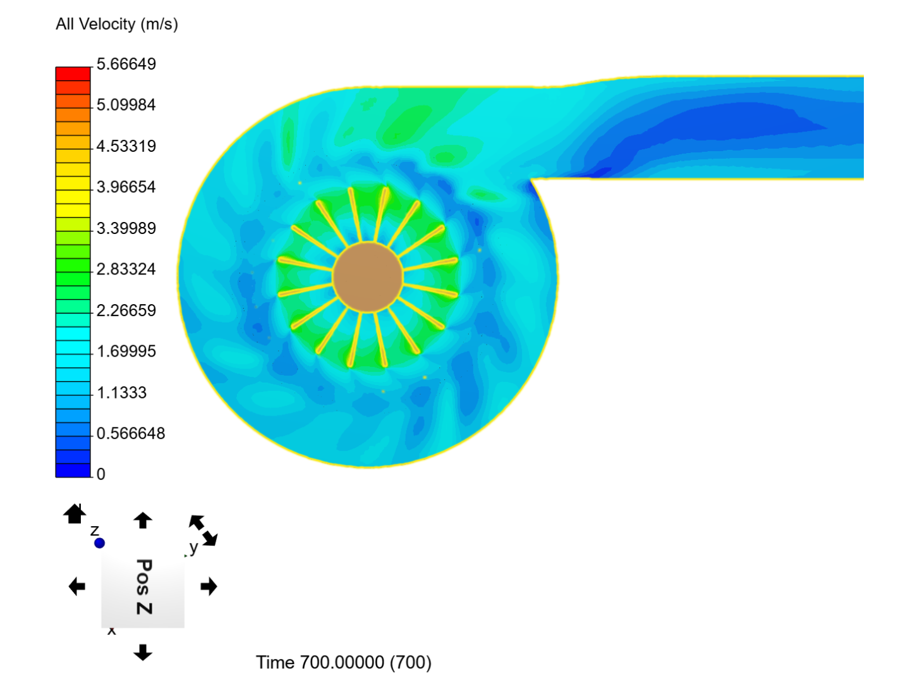
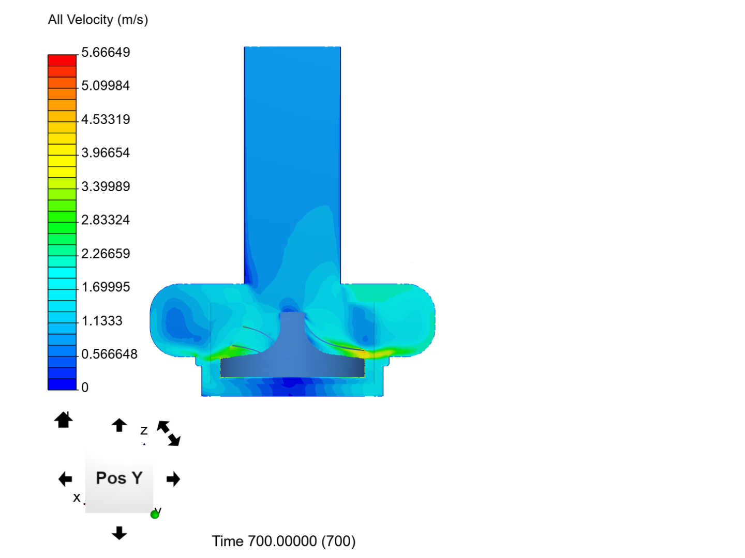
Test Case – Postprocessing
Velocity

Slide 9
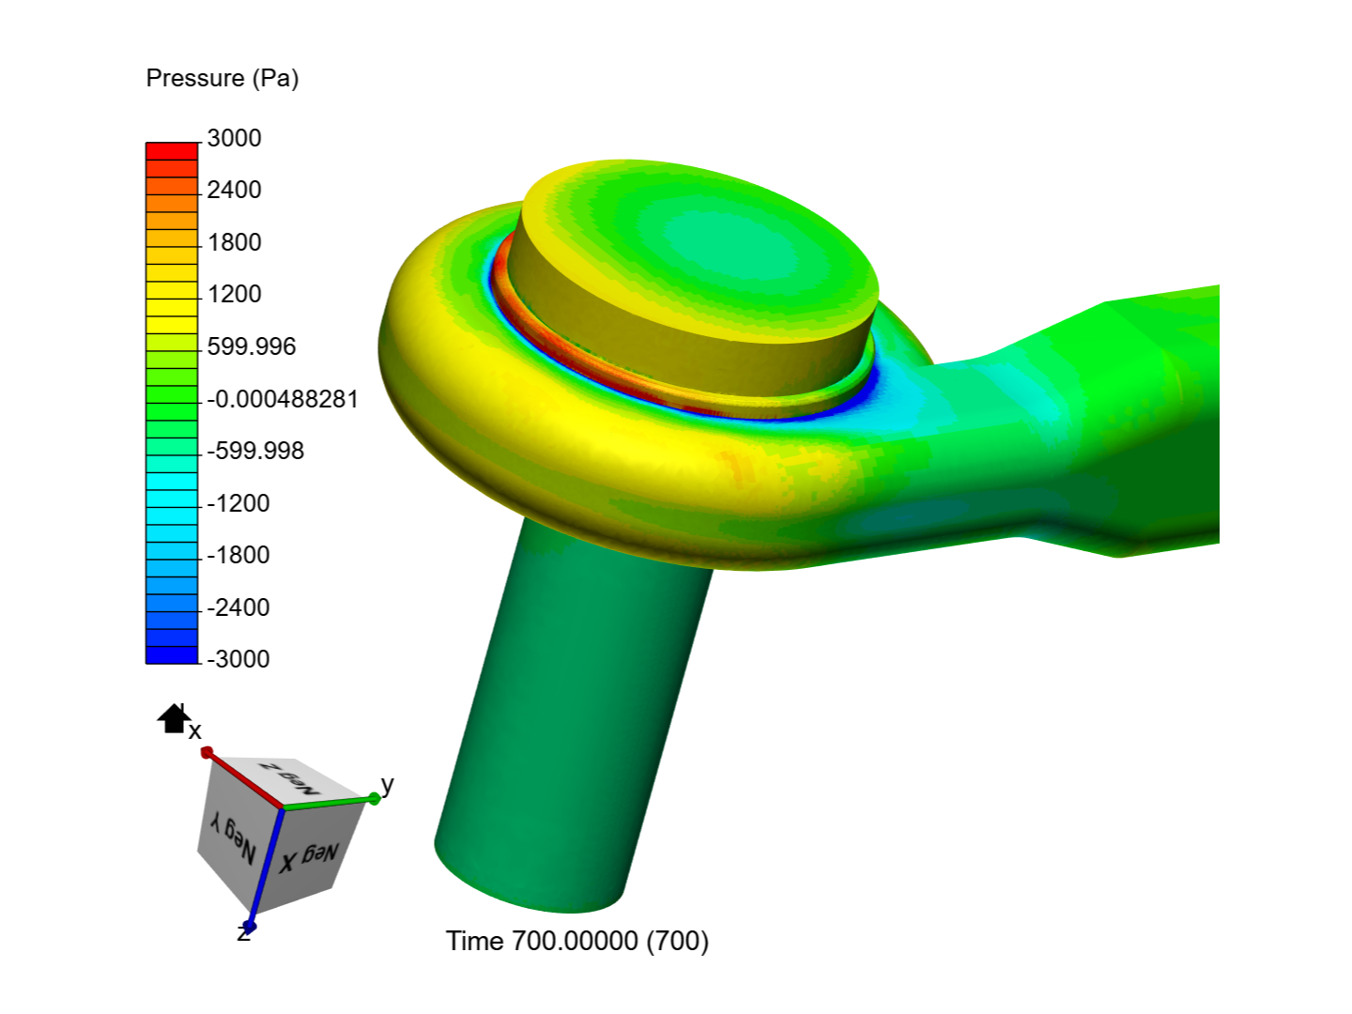
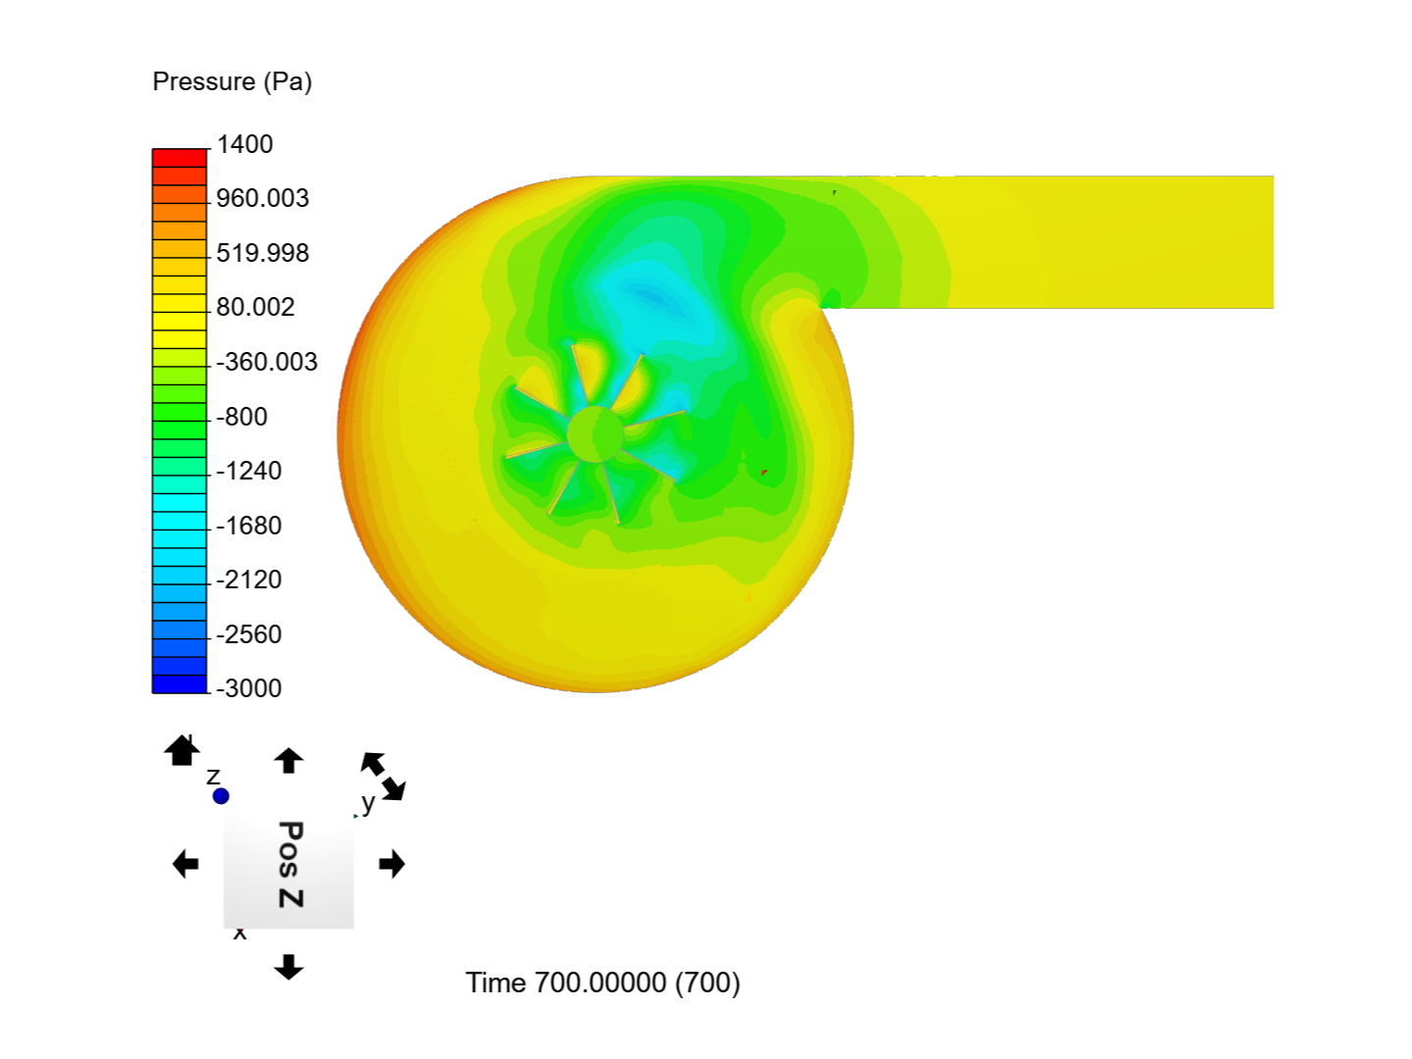
Test Case – Postprocessing
Pressure

Slide 10
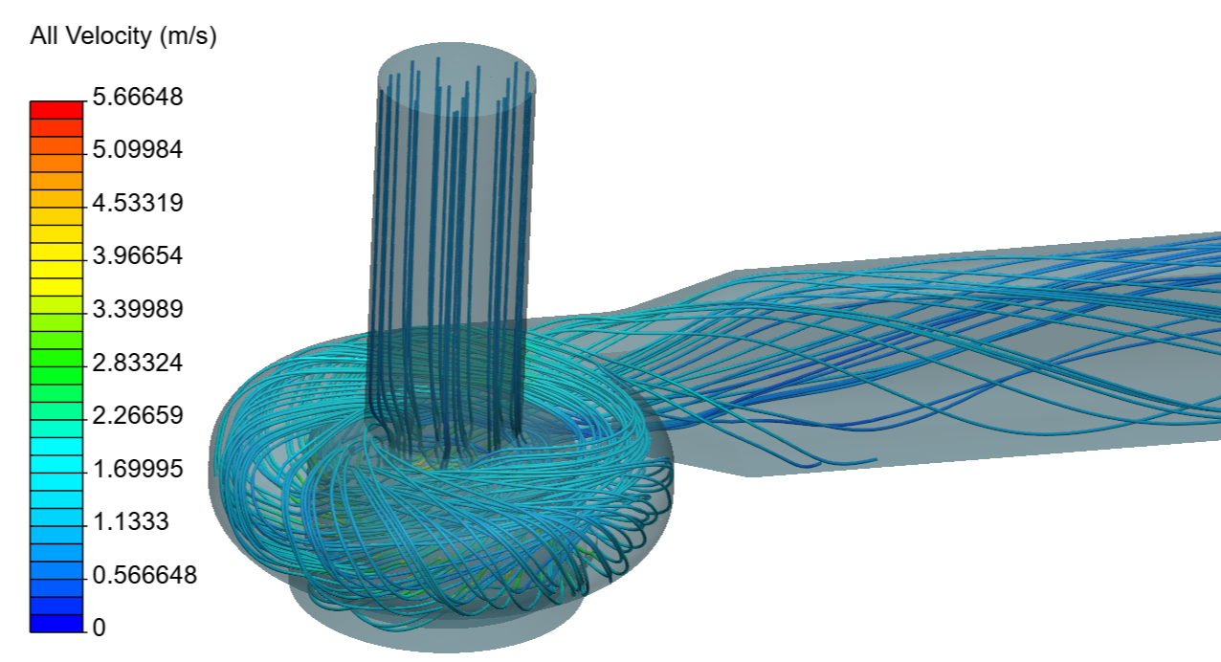
Test Case – Postprocessing
Streamlines

Slide 11
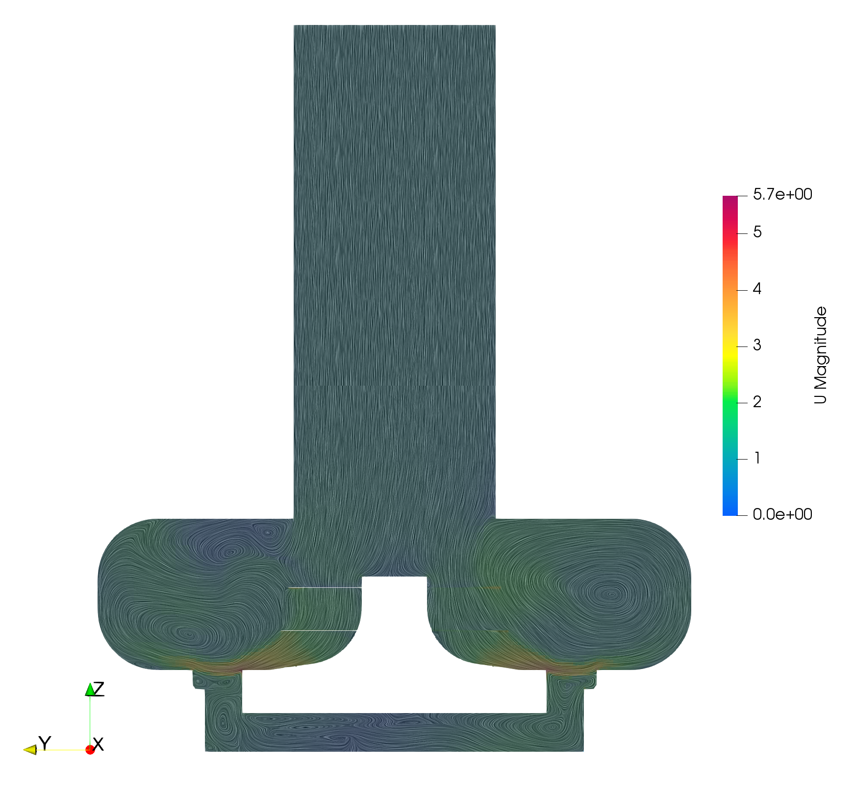
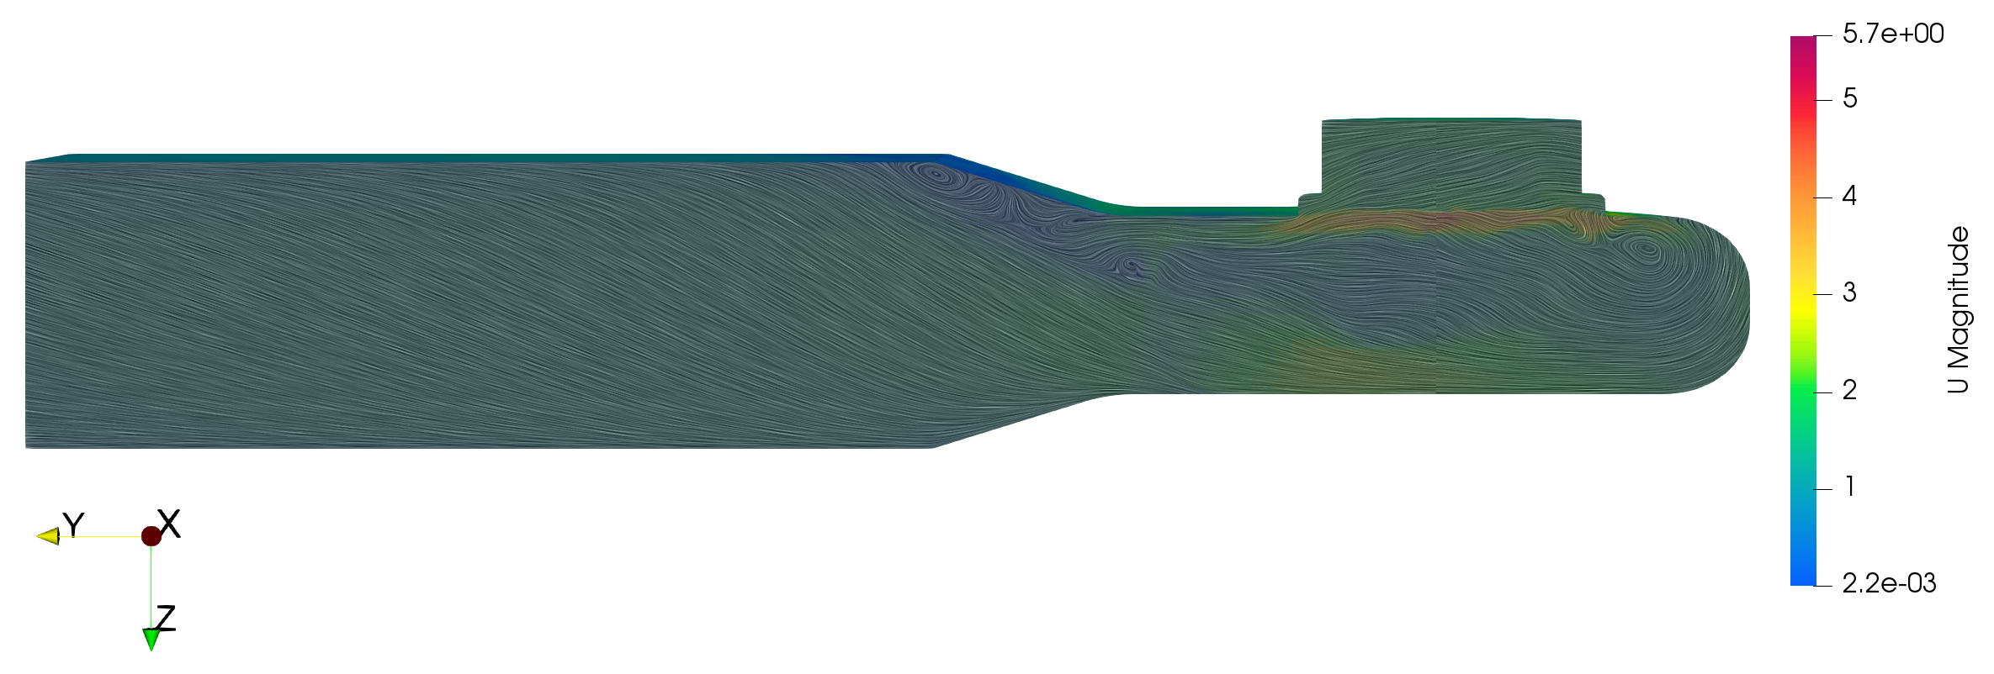
Test Case – Postprocessing
Recirculation
Sharp corner can be removed to reduce recirculation

Slide 12
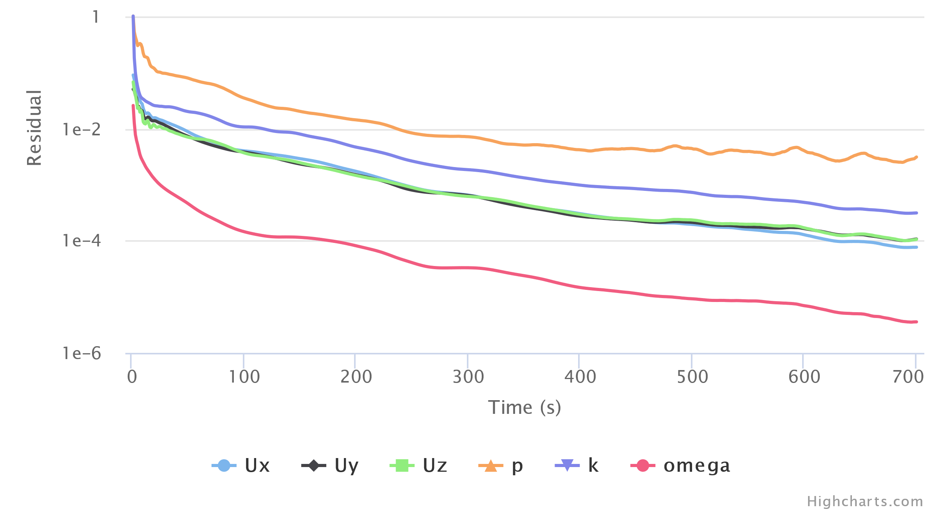
Test Case – Postprocessing
Convergence
Notes:
- Used to see how the model is converging through different iterations

Slide 13
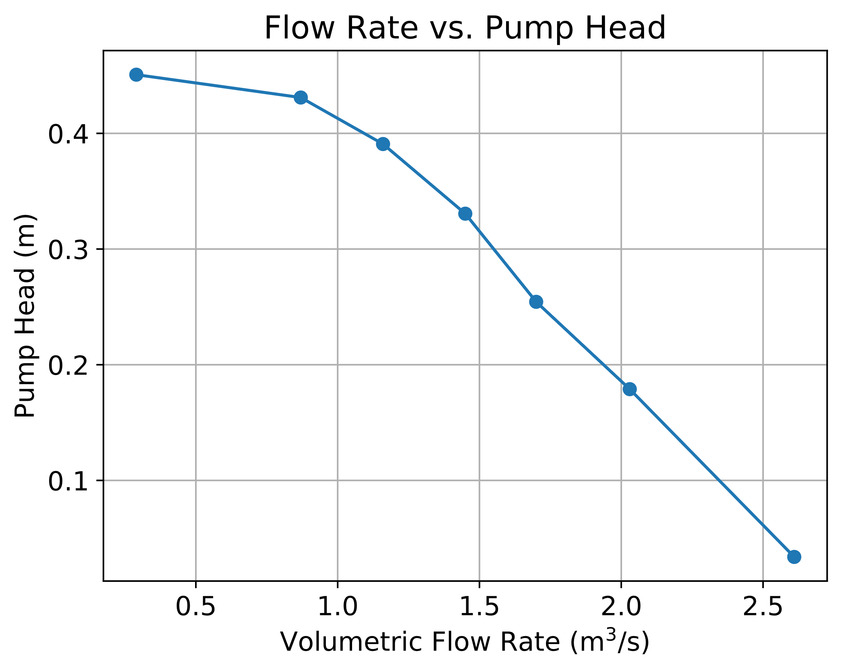
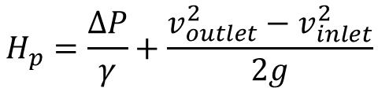
Test Case – Pump Curve
Data from the CFD results:
Inlet and outlet velocities
Inlet pressure
Equation:
$$H_{p}=\frac{∆P}{γ}+\frac{v_{outlet}^{2}−v_{inlet}^{2}}{2g}$$

Slide 14
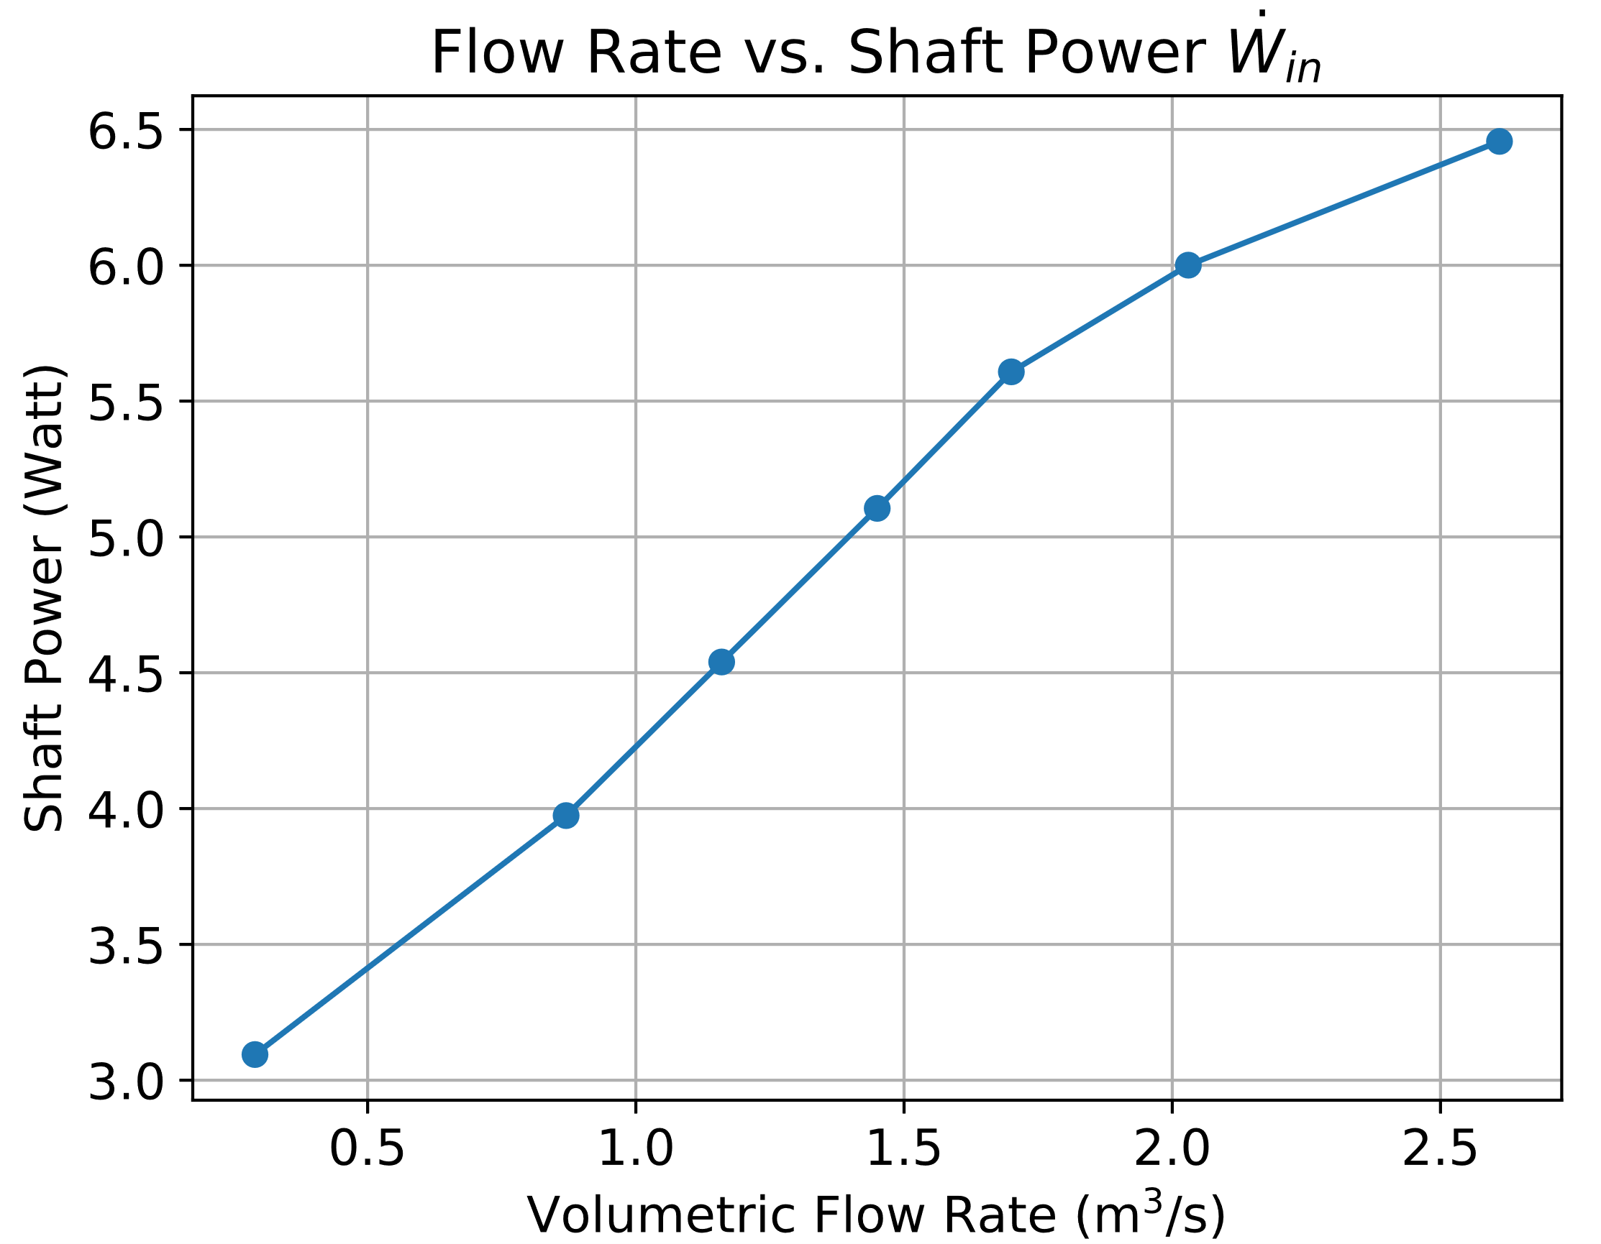
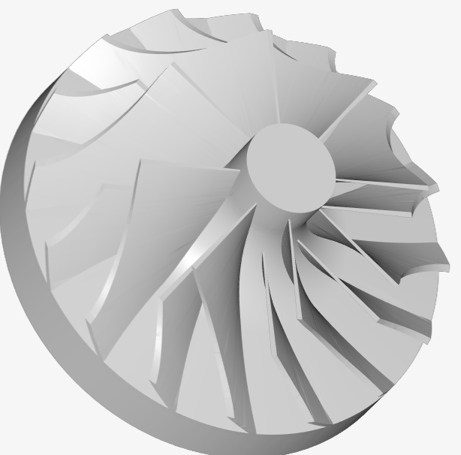
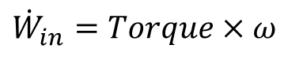
Test Case – Pump Curve
Data from the CFD results:
Moment (z-axis) of the impeller
Equation:
$${\dot{W}}_{in}=Torque×ω$$
z
Clockwise rotation

Slide 15
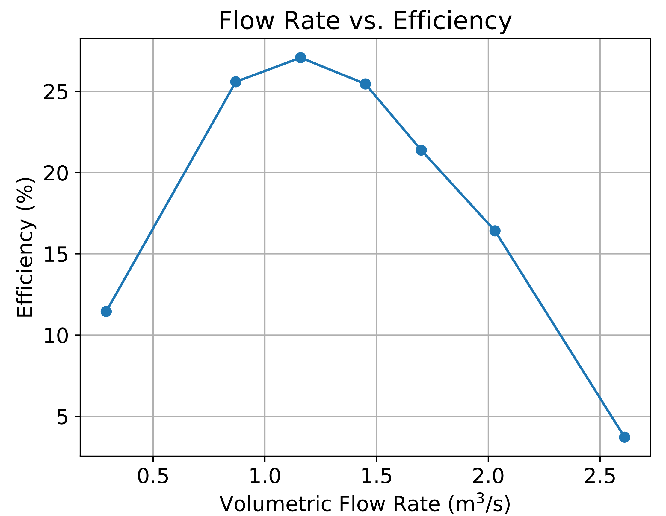
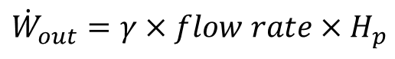
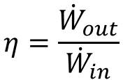
Test Case – Pump Curve
Equation:
Best Efficiency Point
$$η=\frac{{\dot{W}}_{out}}{{\dot{W}}_{in}}$$
Water power:
$${\dot{W}}_{out}=γ×flow rate×H_{p}$$

Slide 16
Test Case
Area average
Volumetric flow rate | Mass flow rate
 | Inlet | Outlet
0.29 | 8.0E-05 | 8.0E-05
0.87 | 2.4E-04 | 2.4E-04
1.16 | 3.2E-04 | 3.2E-04
1.45 | 4.0E-04 | 4.0E-04
1.7 | 4.8E-04 | 4.8E-04
2.03 | 5.6E-04 | 5.6E-04
2.61 | 7.2E-04 | 7.2E-04
A stable and converged simulation:
Can be verified with an area average at the inlet and outlet
Notes:
The mass flow rate is equal at the inlet and outlet

Slide 17
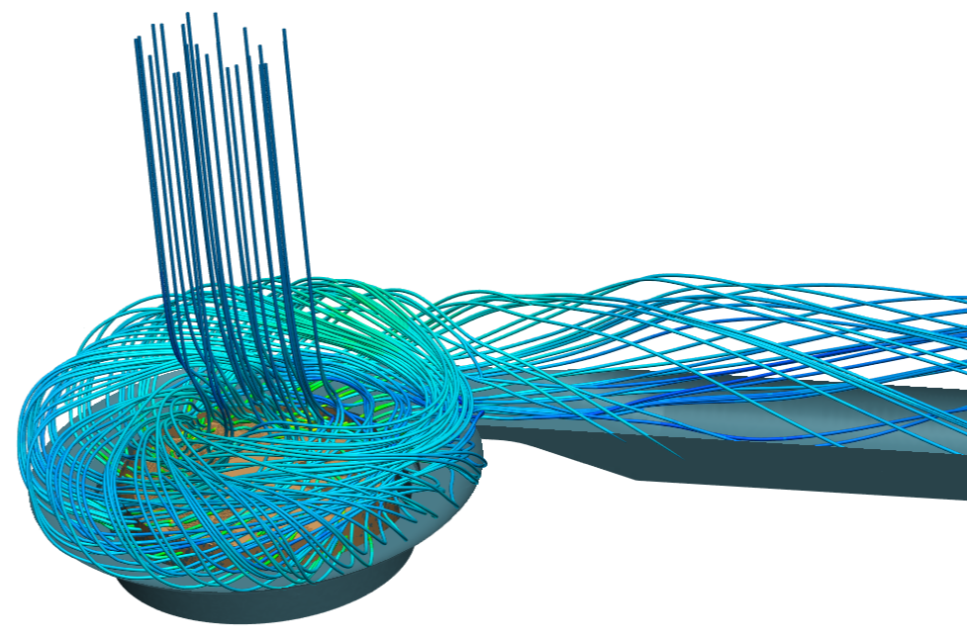
Result Summary
CFD saves a lot of time and money
It can give pump curves
It is efficient for selecting the optimum:
Blade number
Blade angle
Housing geometry
Notes:
- Snap-shot is taken from the simulation of the test case pump in the following slides

